Slide 1
Evaluating Home Renovation Opportunities in King County, WA
Analysis by Brian Bentson

Slide 2
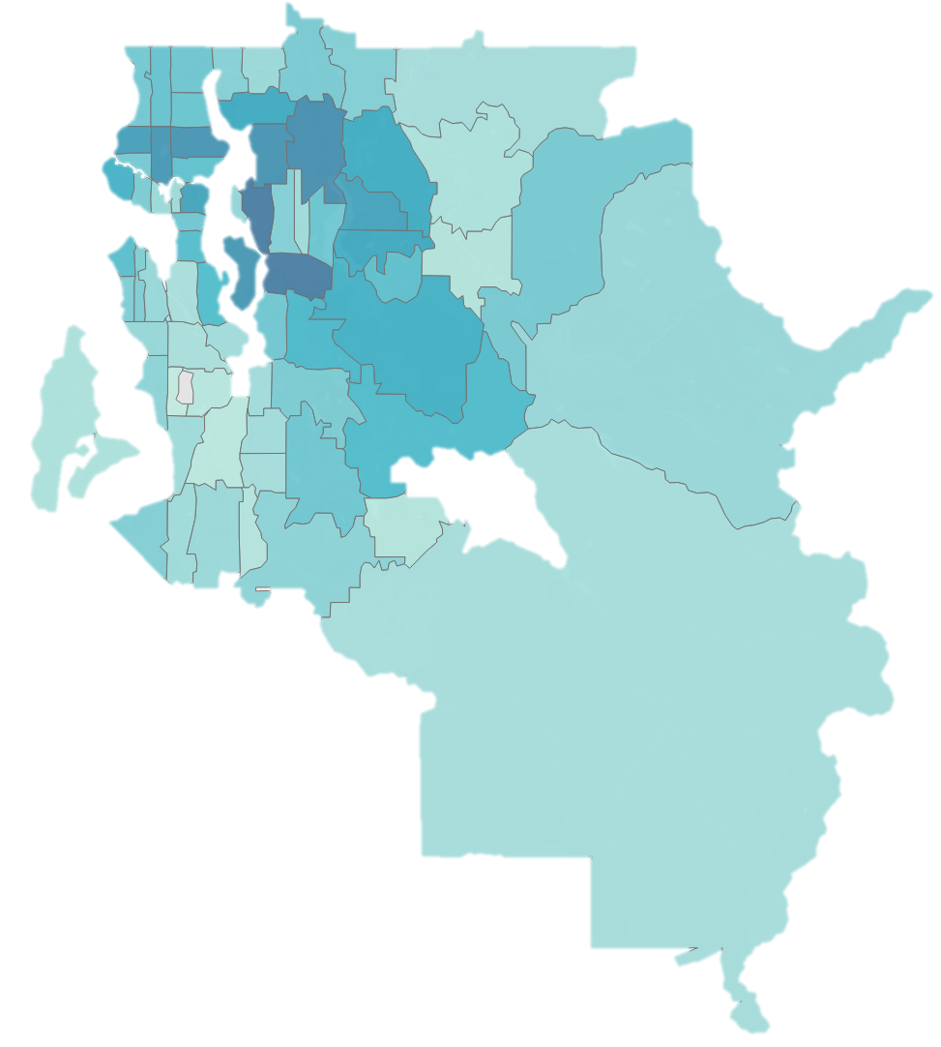

Analysis Overview
~17,000 home sales analyzed from 2014 and 2015
Small and Midsize homes with less than 6 bedrooms
Linear Regression Modeling to understand how housing features affect price
Seattle

Slide 3
Recommendations
I recommend adding a full bathroom (~60 sqft) which will add roughly $22,000 to the value of a home
Use high grade construction materials. Every higher level of materials yields $49,280/level
Improve the view of and from your property by adding landscaping. Each higher level of view yields a $
DO’s
DON’Ts
Controllable | Potential Value
Adding a Bathroom | $22,000/bathroom
Adding Square Feet | $120/sqft
Improving the “View” | $35,380/level
Using High Grade Construction | $49,280/level
Controllable | Potential Value
Adding a Bathroom | $22,000
Adding Square Feet | $120/sqft
Improving the “View” | $35,380
Using High Grade Construction | $49,280

Slide 4
Title and Content Layout with Chart

Slide 5
Two Content Layout with Table
First bullet point here
Second bullet point here
Third bullet point here
Class | Group 1 | Group 2
Class 1 | 82 | 95
Class 2 | 76 | 88
Class 3 | 84 | 90

Slide 6
Title and Content Layout with SmartArt
Step 1 Title
Task description
Task description
Step 2 Title
Task description
Step 3 Title
Task description
Task description
Task description

Slide 7
Add a Slide Title - 1

Slide 8
Add a Slide Title - 2

Slide 9
Add a Slide Title - 3

Slide 11
Add a Slide Title - 4

Slide 12
Add a Slide Title - 5

